Slide 1
Chapter 14 Time-Series Analysis
Copyright © 2022 McGraw Hill. All rights reserved. No reproduction or distribution without the prior written consent of McGraw Hill.
1-1

Slide 2
Chapter Learning Objectives
Chapter 14
LO14-1: Define time-series data and its components.
LO14-2: Interpret a linear, exponential, or quadratic trend model.
LO14-3: Fit any common trend model and use it to make forecasts.
LO14-4: Know the definitions of common fit measures.
LO14-5: Interpret a moving average and use Excel to create it.
LO14-6: Use exponential smoothing to forecast trendless data.
LO14-7: Interpret seasonal factors and use them to make forecasts.
LO14-8: Use regression with seasonal binaries to make forecasts.
LO14-9: Interpret index numbers.

Slide 3
Time-Series Data
LO 14-1
A time-series variable (denoted Y) consists of data observed over n periods of time.
Businesses use time-series data:
To monitor a process to determine if it is stable
To predict the future (forecasting)
It is customary to plot time-series data either as a line graph or as a bar graph, with time on the horizontal X-axis and the variable of interest on the vertical Y-axis to reveal how the variable changes over time.
In a line graph, the X-Y data points are connected with line segments to make it easier to see fluctuations.

Slide 4
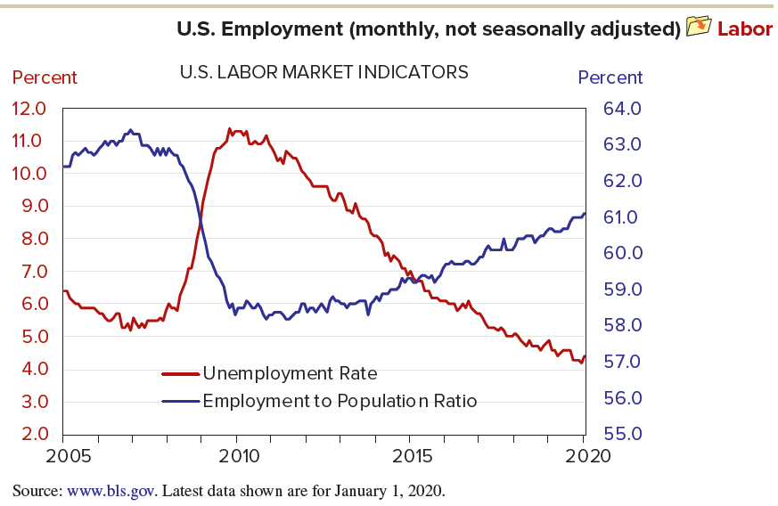
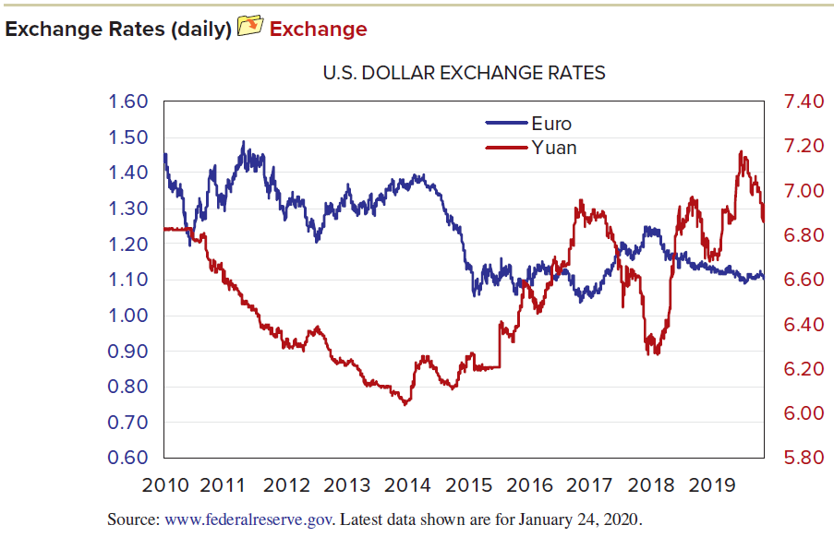
Time-Series Data
LO 14-1
Fluctuations are easier to see on a line graph.
The following notation is used: y_{t} is the value of the time series in period t (t is an index denoting the time period t = 1, 2, …, n); n is the number of time periods y₁, y₂, …, y_{n} is the data set for analysis.

Slide 5
Time-Series Data
LO 14-1
Time-series data may be measured at a point in time.
For example, prime rate of interest is measured at a particular point in time.
Time-series data may also be measured over an interval of time.
For example, Gross Domestic Product (GDP) is a flow of goods and services measured over an interval of time.

Slide 6
Periodicity
LO 14-1
The periodicity is the time interval over which data are collected (decade, year, quarter, month, week, day, hour).
Firms typically report profits by quarter but pension liabilities only at year’s end.
Any periodicity is possible, but the principles of time-series modeling can be understood with three common data types:
Annual data (1 observation per year)
Quarterly data (4 observations per year)
Monthly data (12 observations per year)

Slide 7
Time-Series Components
LO 14-1
Time-series decomposition seeks to separate a time-series Y into four components:
trend (T)
cycle (C)
seasonal (S)
irregular (I)
These components are assumed to follow either an additive model or a multiplicative model

Slide 8
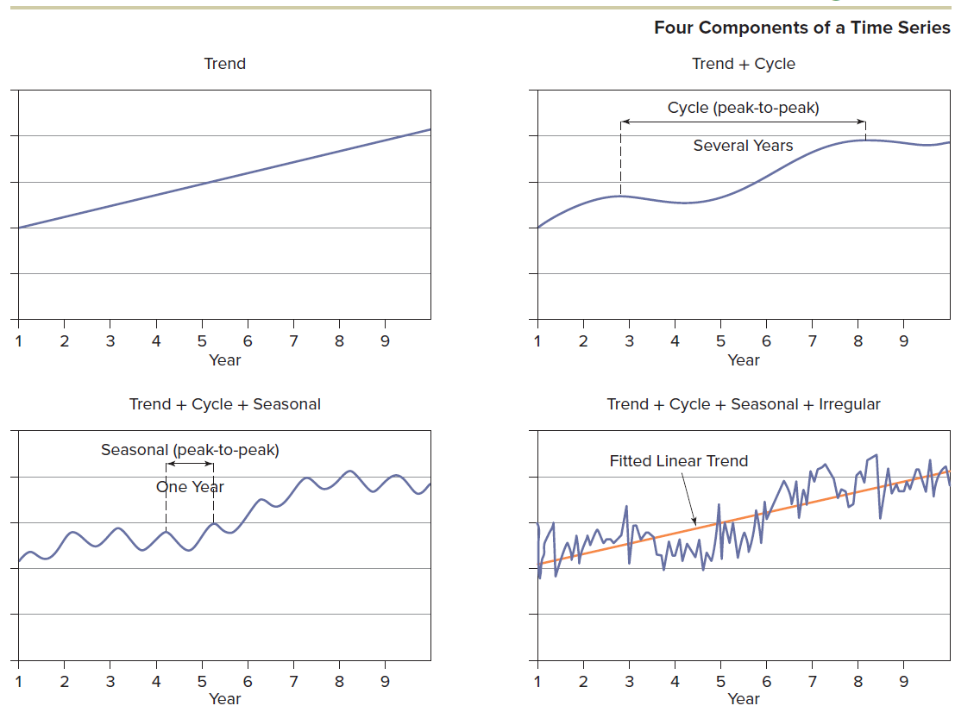
Time-Series Components
LO 14-1

Slide 9
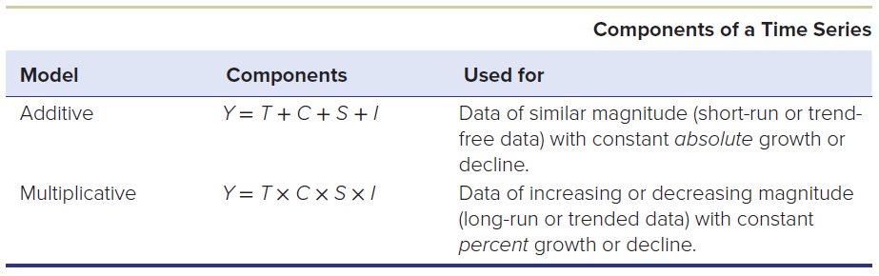
Time-Series Components
LO 14-1
The additive form is attractive for its simplicity, but the multiplicative model is often more useful for forecasting financial data, particularly when the data vary over a range of magnitudes.

Slide 10
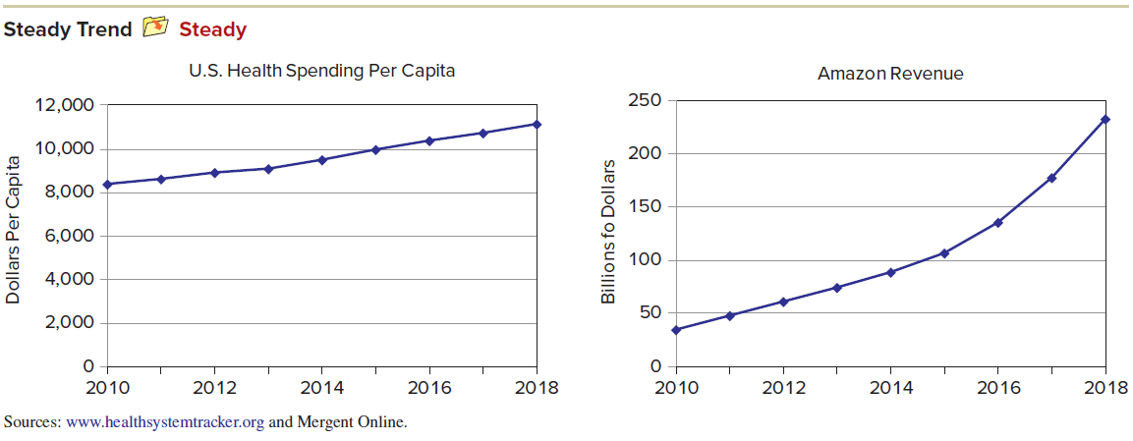
Trend
LO 14-1
Trend (T) is a general movement over all years (t = 1, 2, . . ., n). Change over a few years is not a trend. Some trends are steady and predictable.
A mathematical trend can be fitted to any data, but its predictive value depends on the situation.

Slide 11
Cycle
LO 14-1
Cycle (C) is a repetitive up-and-down movement around the trend that covers several years.
For example, industry analysts have studied cycles for sales of new automobiles, new home construction, inventories, and business investment.
Although cycles are conceptually important, there is no general theory of cycles, and even those cycles that have been identified in specific industries have erratic timing and complex causes that defy generalization.

Slide 12
Seasonal
LO 14-1
Seasonal (S) is a repetitive cyclical pattern within a year.
For example, many retail businesses experience strong sales during the fourth quarter because of Christmas. Automobile sales rise when new models are released. Peak demand for airline flights to Europe occurs during summer vacation travel.

Slide 13
Irregular
LO 14-1
Irregular (I) is a random disturbance that follows no apparent pattern. It also is called the error component or random noise reflecting all factors other than trend, cycle, and seasonality.
For example, daily prices of many common stocks fluctuate greatly.

Slide 14
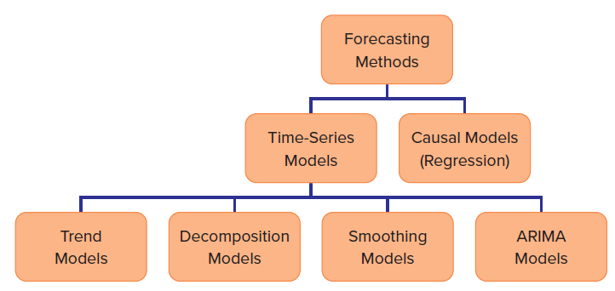
Trend Forecasting
LO 14-2
There are many forecasting methods designed for specific situations.
Overview of forecasting:

Slide 15
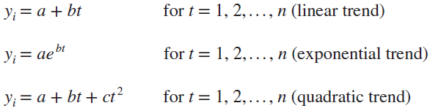
Three Trend Models
LO 14-2
There are many possible trend models, but three of them are especially useful in business:
All three models can be fitted by Excel

Slide 16
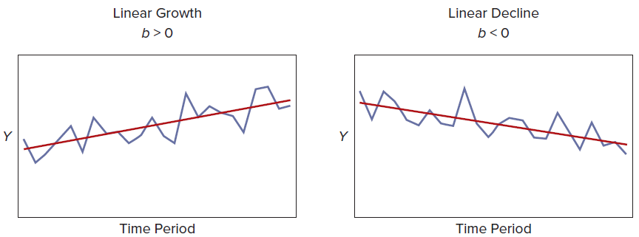
Linear Trend Model
LO 14-2
The linear trend model has the form y_{t} = a + bt. It is useful for a time series that grows or declines by the same amount (b) in each period.
It is generally preferred in business as a baseline forecasting model unless there are compelling reasons to consider a more complex model.

Slide 17
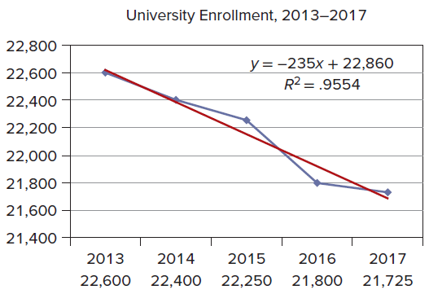
Illustration: Linear Trend
LO 14-2
Following the population “echo boom,” some U.S. states (especially in the Northeast and Midwest) began to see declines in the number of high school graduates. Concerned about its potential loss of traditional student populations aged 18–25, a Midwestern university wanted to extrapolate the recent trend in fall semester enrollments. The slope of Excel’s fitted trend, indicates that, on average, the university has lost 235 students per year.

Slide 18
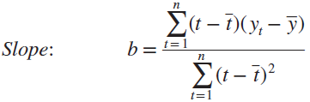

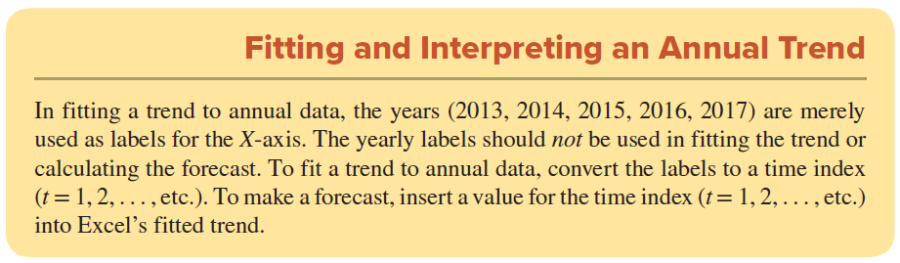
Linear Trend Calculations
LO 14-2
The linear trend is fitted in the usual way by using the ordinary least squares formulas.

Slide 19
Forecasting a Linear Trend
LO 14-2
We can make a forecast for any future year by using the fitted model y_{t} = 22,860 − 235t. In the enrollment example, the fitted trend equation is based on only 5 years’ data, so we should be wary of extrapolating very far ahead:
For 2018 (t = 6): y₆ = 22, 860 − 235(6) = 21, 450
For 2019 (t = 7): y₇ = 22, 860 − 235(7) = 21, 215
For 2020 (t = 8): y₈ = 22, 860 − 235(8) = 20, 980

Slide 20
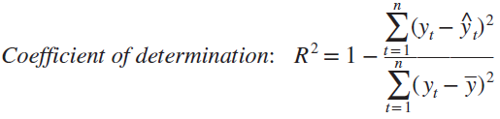
Linear Trend: Calculating R²
LO 14-2
R² can be calculated as:
As R² close to 1.0 would indicate a good fit to the past data.
However, a good fit to the past data does not guarantee good future forecasts, unless all things remain the same as for the fitted model.

Slide 21
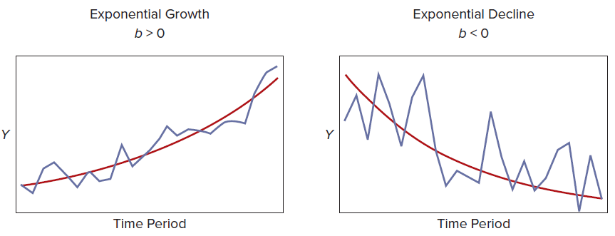
Exponential Trend Model
LO 14-3
The exponential trend model has the form y_{t} = ae^{bt}.
It is useful for a time series that grows or declines at the same rate (b) in each period.

Slide 22
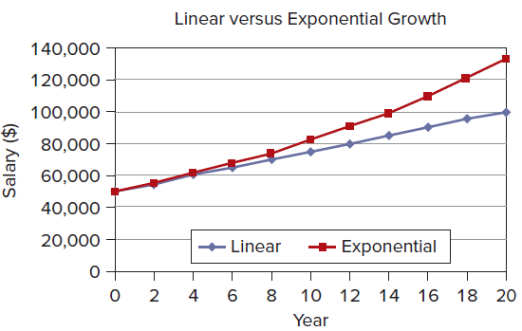
When to Use the Exponential Model
LO 14-3
This model is often preferred for financial data or data that covers a longer period of time.
You can compare two growth rates in two time series variables with dissimilar data units (i.e., a percent growth rate is unit-free).
There may not be much difference between a linear and an exponential model when the growth rate is small and the data set covers only a few time periods.
The linear model (y_{t} = a + bt) and the exponential model (y_{t} = ae^{bt}) are equally simple because they are two-parameter models and a log-transformed exponential model is actually linear.

Slide 23
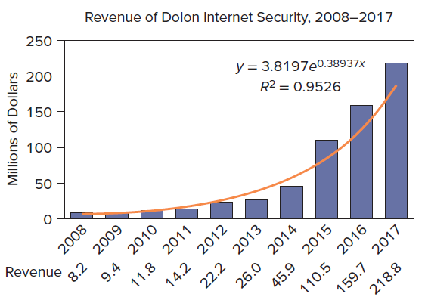
Illustration: Exponential Trend
LO 14-3
Spending on Internet security in the United States has shown explosive growth. For example revenue growth for one web security company. Clearly, a linear trend (constant dollar growth) would be inadequate. It is more reasonable to assume a constant percent rate of growth and fit an exponential model. Excel’s fitted exponential trend is y_{t} = 3.8197e^{0.3894t}. The value of b in the exponential model y_{t} = ae^{bt} is the continuously compounded growth rate, so we can say that Dolon’s revenue is growing at an astonishing rate of 38.94 percent per year.

Slide 24
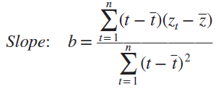

Exponential Trend Calculations
LO 14-3
Calculations of the exponential trend are done by using a transformed variable z_{t} = ln(y_{t}) to produce a linear equation so that the least squares formulas can be used.
Once the least squares calculations are completed, transform the intercept back to the original units by exponentiation to get the correct intercept.

Slide 25
Forecasting an Exponential Trend
LO 14-3
We can make a forecast of debit card usage for any future year by using the fitted model:
For 2018 (t = 11): y₁₁ = 3.8197e^{0.38937(11)} = 276.8
For 2019 (t = 12): y₁₂ = 3.8197e^{0.38937(12)} = 408.5
For 2020 (t = 13): y₁₃ = 3.8197e^{0.38937(13)} = 603.0
Can Dolon’s revenue actually continue to grow at a rate of 38.937 percent? It seems unlikely. Typically, when a new product is introduced, its growth rate at first is very strong but eventually slows down as the market becomes saturated and/or as competitors arise.

Slide 26
Quadratic Trend
LO 14-3
A quadratic trend model has the form y_{t} = a + bt + ct².
If c = 0, then the quadratic model becomes a linear model (i.e., the linear model is a special case of the quadratic model).
Fitting a quadratic model is a way of checking for nonlinearity.
If c does not differ significantly from zero, then the linear model would suffice.

Slide 27
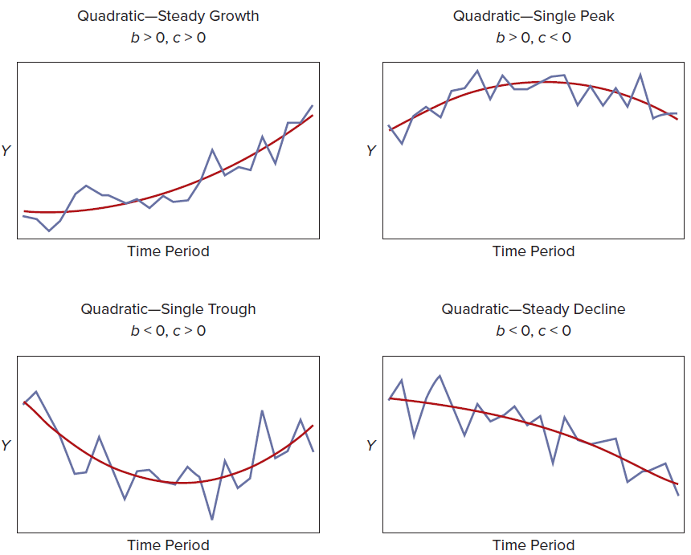
Quadratic Trend
LO 14-3
Depending on the values of b and c, the quadratic model can assume any of four shapes as shown.

Slide 28
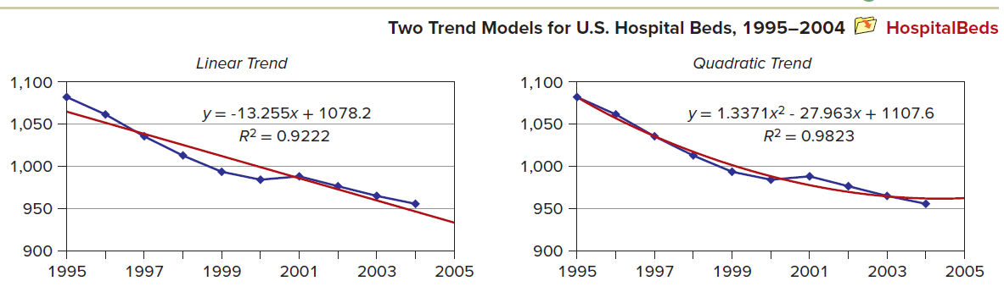
Illustration: Quadratic Trend
LO 14-3
The number of hospital beds in the United States declined during the late 1990s, showed signs of leveling out, and then declined again. What trend would we choose if the objective is to make a realistic one-year forecast?

Slide 29
Trend-Fitting Criteria
LO 14-3
Criteria for selecting a trend forecasting model:
Criterion | Ask Yourself
Occam's Razor | Would a simpler model suffice?
Overall fit | How does the trend fit the past data?
Believability | Does the extrapolated trend “look right"?
Fit to recent data | Does the fitted trend match the last few data points?

Slide 30
Example: Comparing Trends
LO 14-3
You can usually increase the R² by choosing a more complex model. But if you are making a forecast, this is not the only relevant issue because R² measures the fit to the past data. The next slide shows four fitted trends using the same data, with three-period forecasts. For this data set, the linear model may be inadequate because its fit to recent periods is marginal (we prefer the simplest model only if it “does the job”). The cubic trend yields the highest R², but the fitted equation is nonintuitive and would be hard to explain or defend. Also, its forecasts appear to be increasing too rapidly. In this example, the exponential model has the lowest R², yet it matches the recent data fairly well and its forecasts appear credible when projected a few periods ahead.

Slide 31
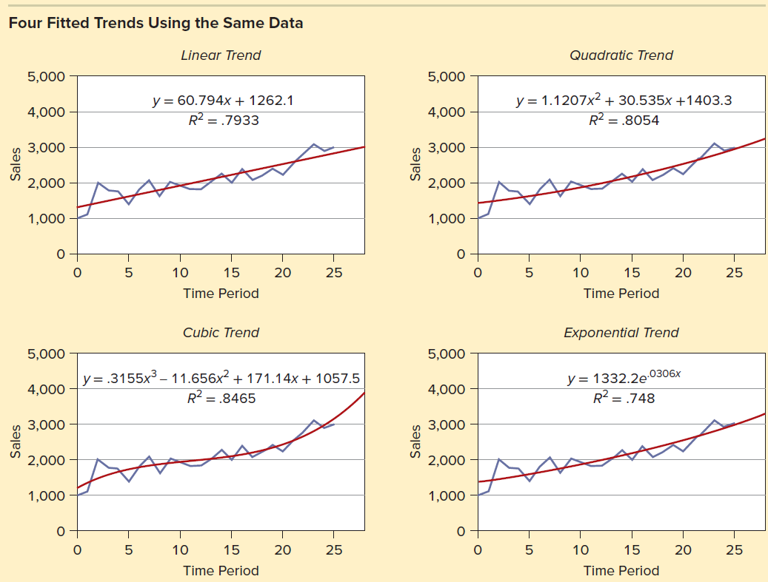
Example: Comparing Trends
LO 14-3

Slide 32
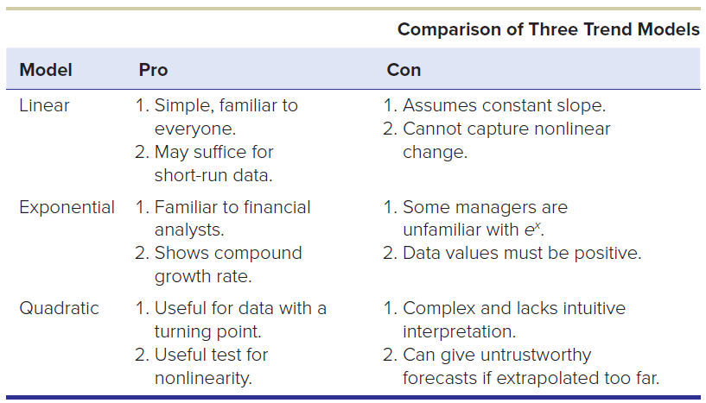
Example: Comparing Trends
LO 14-3
Any trend model’s forecasts become less reliable as they are extrapolated farther into the future.
Consider the following three trend models:

Slide 33
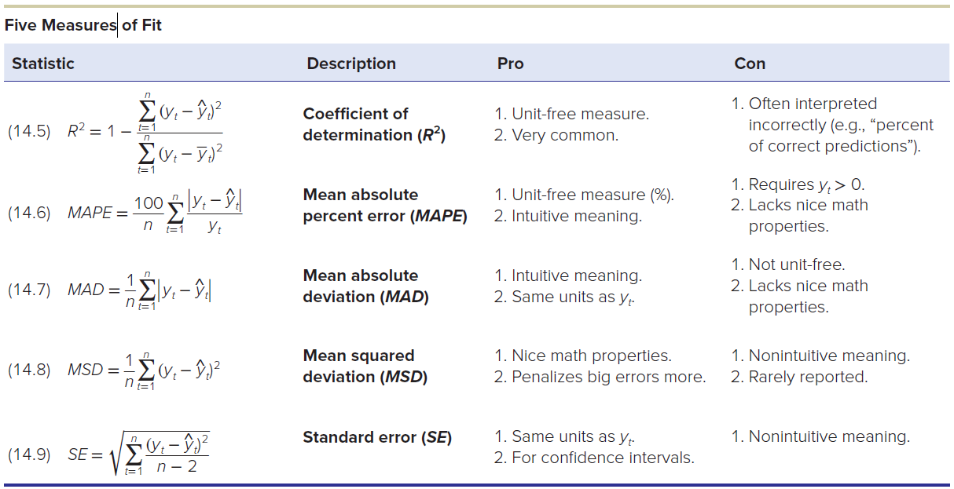
Five Measures of Fit
LO 14-4
“Fit” refers to how well the estimated trend model matches the observed historical past data. Note a good fit is no guarantee of good forecasts.

Slide 34
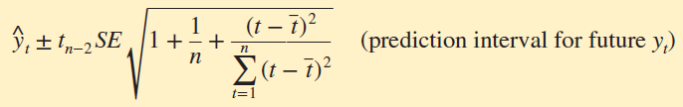
Interpretation
LO 14-4
These fit statistics are most useful in comparing different trend models for the same data.
All the statistics (especially the MSD) are affected by unusual residuals.
The standard error (SE) is useful if we want to make a prediction interval for a forecast.

Slide 35
Trailing Moving Average (TMA)
LO 14-5
The simplest kind of moving average is the trailing moving average (TMA) over the last m periods.
The TMA smooths the past fluctuations in the time series, helping us see the pattern more clearly.
Choosing a larger m yields a “smoother” TMA but requires more data.

Slide 36
Centered Moving Average (CMA)
LO 14-5
The CMA smoothing method looks forward and backward in time to express the current “forecast” as a mean of the current observation and observations on either side of the current data.
For m = 3
When m is odd (m = 3, 5, etc.), the CMA is easy to calculate.
When m is even, the mean of an even number of data points would lie between two data points and would not be correctly centered.
In this case, we would take a double moving average to get the resulting CMA centered properly.

Slide 37
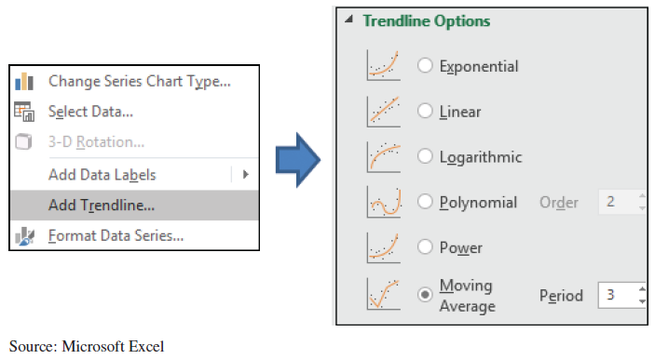
Using Excel for a TMA
LO 14-5
Excel offers a TMA in its Add Trendline option when you click on a time-series line graph or bar chart. Its menus are displayed. The TMA is a conservative choice whenever you doubt that one of Excel’s five other trend models (linear, logarithmic, polynomial, power, exponential) would be appropriate. However, Excel does not give you the option of making any forecasts with its moving average model.

Slide 38
Exponential Smoothing
LO 14-6
The exponential smoothing model is a special kind of moving average.
Its one-period-ahead forecasting technique is utilized for data that has up-and-down movements but no consistent trend.
The updating formula is:
Where
F_{t+1} = the forecast for the next period
α = the “smoothing constant” (0 ≤ α ≤ 1)
y_{t} = the actual data value in period t
F_{t} = the previous forecast for period t

Slide 39
Smoothing Constant (α)
LO 14-6
The next forecast F_{t+1} is a weighted average of y_{t} (the current data) and F_{t} (the previous forecast).
The value of α (the smoothing constant) is the weight given to the latest data.
A small value of α would give low weight to the most recent observation and heavy weight 1 − α to the previous forecast.
A large value of α would give heavy weight to the previous forecast.
The larger the value of α, the more quickly the forecasts adapt to recent data.

Slide 40
Choosing the Value of α
LO 14-6
If α = 1, there is no smoothing at all, and the forecast for the next period is the same as the latest data point.
The effect of our choice of α on the forecast diminishes as time increases.
To see this, replace F_{t} with F_{t-1} and repeat this type of substitution indefinitely to obtain:
The next forecast depends on all the prior data.
Note that F_{t-1} depends on F_{t}, which in turn depends on F_{t-1}, and so on all the way back to F₁.

Slide 41
Initializing the Process
LO 14-6
Where do we get the initial forecast F₁ (i.e., how do we initialize the process)?
Method A
Use the first data value
Set F₁ = y₁
Although simple, if y₁ is unusual, it could take a few iterations for the forecasts to stabilize.
Method B
Average the first 6 data values
Set F₁ = (y₁ + y₂ + y₃ + y₄ + y₅ + y₆)/6
This method consumes more data and is still vulnerable to unusual y-values.

Slide 42
Smoothing with Trend and Seasonality
LO 14-6
Single exponential smoothing is for trendless data.
For data with a trend, use Holt’s method with two smoothing constants (one for trend and one for level).
For data with both trend and seasonality, use Winters’s method with three smoothing constants (for trend, level, and seasonality).
These topics are usually reserved for a class in forecasting, so they will not be explained here.

Slide 43
Seasonality
LO 14-7
When the data periodicity is monthly or quarterly, we should calculate a seasonal index and use it to deseasonalize the data (annual data have no seasonality).
This process is called decomposition of a time series.
The seasonal indexes must sum to 12 for monthly data or to 4 for quarterly data.
The following steps are used to deseasonalize data for time-series observations: (refer to the next slide).

Slide 44
Seasonality
LO 14-7
The following steps are used to deseasonalize data for time-series observations:
Step 1: Calculate a centered moving average (CMA) for each month (quarter).
Step 2: Divide each observed y_{t} value by the CMA to obtain seasonal ratios.
Step 3: Average the seasonal ratios by month (quarter) to get raw seasonal indexes.
Step 4: Adjust the raw seasonal indexes so they sum to 12 (monthly) or 4 (quarterly).
Step 5: Divide each y_{t} by its seasonal index to get deseasonalized data.

Slide 45
Seasonal Forecasts Using Binary Predictors
LO 14-8
Another way to address seasonality is to estimate a regression model using seasonal binaries as predictors.
For quarterly data, for example, we will have four binaries (i.e., four quarters).
One must be excluded to prevent perfect multicollinearity. Arbitrarily, we exclude the fourth quarter binary Qtr4 (it will be a portion of the intercept when Qtr1 = 0 and Qtr2 = 0 and Qtr3 = 0).
See text for examples

Slide 46
Index Numbers
LO 14-9
A simple way to measure changes over time is to convert time-series data into index numbers.
The idea is to create an index that starts at 100 in a base period.
Indexes are most often used for financial data (e.g., prices, wages, costs) but can be used with any numerical data (e.g., number of units sold, warranty claims, computer spam) .

Slide 47
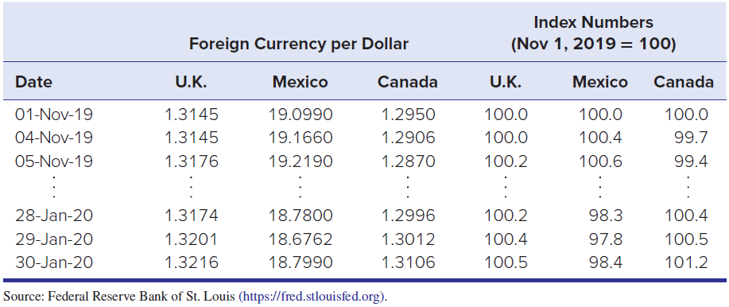
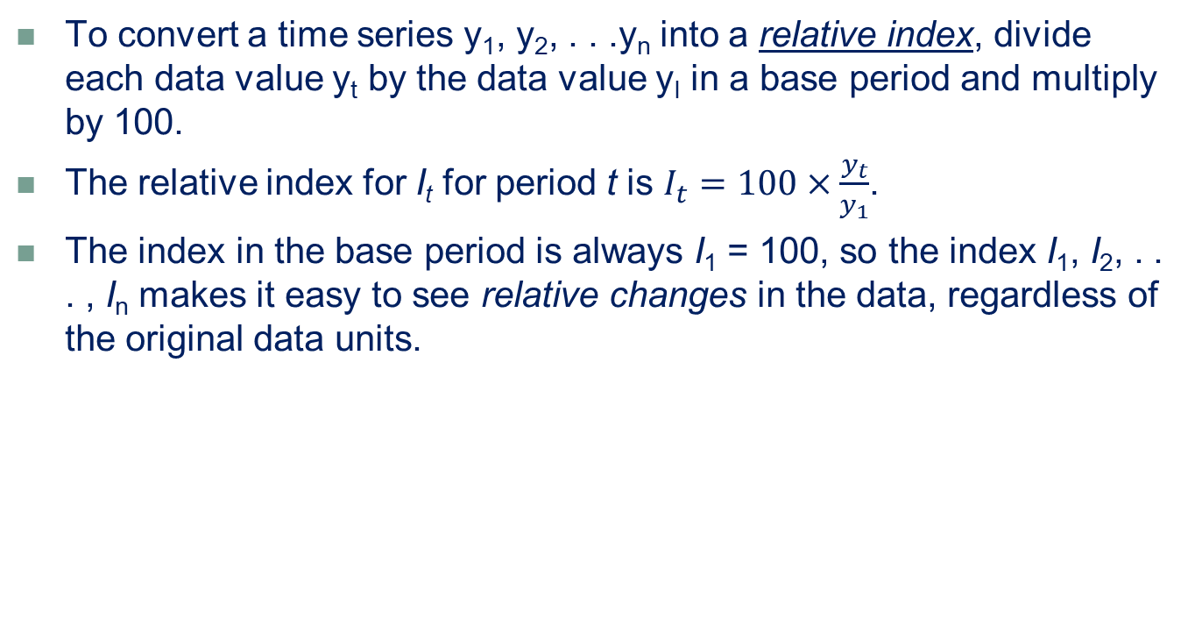
Relative Indexes
LO 14-9
To convert a time series y₁, y₂, . . .y_{n} into a relative index, divide each data value y_{t} by the data value y_{I} in a base period and multiply by 100.
The relative index for I_{t} for period t is $I_{t}=100×\frac{y_{t}}{y_{1}}$.
The index in the base period is always I₁ = 100, so the index I₁, I₂, . . . , I_{n} makes it easy to see relative changes in the data, regardless of the original data units.

Slide 48
Weighted Indexes
LO 14-9
A different calculation is required for a weighted index such as the Consumer Price Index for all urban consumers (CPI-U).
The CPI-U is a measure of the relative prices paid by urban consumers for a market basket of goods and services, based on prices of hundreds of goods and services in eight major groups.
The goal is to make the CPI-U representative of the prices paid for all goods and services purchased by all urban consumers.
This requires assigning weights to each consumer good or service to reflect its importance relative to all the other goods and services in the market basket (e.g., housing gets a higher weight because it is a larger proportion of total spending).

Slide 49
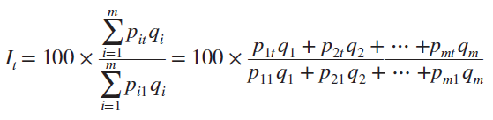
Weighted Indexes
LO 14-9
The basic formula for a simple weighted price index:
Where
I_{t} = weighted index for period t (t = 1, 2, . . . , n)
p_{it} = price of good i in period t (i = 1, 2, . . . , m; t = 1, 2, . . . , n)
q_{i} = weight assigned to good i (i = 1, 2, . . . m)
numerator is the cost of buying a given market basket of goods and services at today’s prices (period t) relative to the cost of the same market basket in the base period (period 1).
The weight qi represents the relative quantity of the item in the consumer's budget.

Slide 50
Importance of Index Numbers
LO 14-9
The CPI affects nearly all Americans because it is used to adjust things like retirement benefits, food stamps, school lunch benefits, alimony, and tax brackets.
The CPI-U could be compared with an index of salary growth for workers, or to measure current-dollar salaries in “real dollars.”
The most widely used CPI-U uses 1982–84 as a reference. That is, the Bureau of Labor Statistics sets the CPI-U (the average price level) for the years 1982, 1983, and 1984 equal to 100, and then measures changes in relation to that figure.
The CPI is based on the buying habits of the “average” consumer, so it may not be a perfect reflection of anyone’s individual price experience.

Slide 51
Importance of Index Numbers
LO 14-9
The Dow Jones Industrial Average (DJIA), have their own unique methodologies.
Originally a simple arithmetic mean of stock prices, the DJIA now is the sum of the 30 stock prices divided by a “divisor” to compensate for stock splits and other changes over time.
The divisor is revised periodically. Because high-priced stocks comprise a larger proportion of the sum, the DJIA is more strongly affected by changes in high-priced stocks.

Slide 52
Role of Forecasting
LO 14-9
Forecasting resembles planning.
Forecasting is an analytical way to describe a “what-if” situation in the future.
Planning is the organization’s attempt to determine a set of actions it will take under each foreseeable contingency.
Forecasts tend to be self-defeating because they trigger homeostatic (state of equilibrium) organizational responses.

Slide 53
Behavioral Aspects of Forecasting
LO 14-9
Forecasts can facilitate organization communication.
A quantitative forecast helps make assumptions explicit.
Forecasts focus the dialogue and can make it more productive.

Slide 54
Forecasts Are Always Wrong
LO 14-9
A forecast is never precise. There is always some error.
Use the error measure to track forecast error.
The Box-Jenkins method uses several different types of time series modeling techniques that fall into a class called ARIMA (Autoregressive Integrated Moving Average) models.
AR (autoregressive) models take advantage of the dependency that might exist between values in the time series.

Slide 55
Forecasts Are Always Wrong
LO 14-9
To ensure good forecast outcomes
Maintain up-to-date databases of relevant data.
Allow sufficient lead time to analyze the data.
State several alternative forecasts or scenarios.
Track forecast errors over time.
State your assumptions and qualifications.
Bear in mind the purpose of the forecasts.
Consider the time horizon for the decision.
Don’t underestimate the power of a good graph.

Slide 56
Chapter 14 Practice Problems

Slide 57
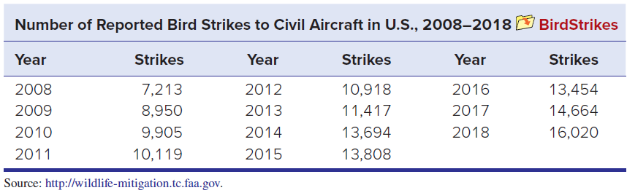
Question 1
LO 14-3
In 2009, US Airways Flight 1549 made a successful emergency landing in the Hudson River, after striking birds shortly after takeoff. Are bird strikes an increasing threat to planes?
a. Make an Excel graph of the data on bird strikes.
b. Discuss the underlying causes that might explain the trend.
c. Fit three trends (linear, quadratic, and exponential) to the time series.
d. Use each of the three fitted trend equations to make numerical forecasts for the next three years. How much difference does the choice of model make? Which forecasts do you trust the most, and why?
BirdStrikes File

Slide 58
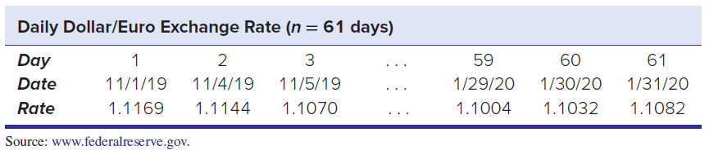
Question 6
LO 14-5
a. Make an Excel line graph of the exchange rate data (only first 3 and last 3 days are shown). Describe the pattern.
b. Click on the data and choose Add Trendline > Moving Average. Describe the effect of increasing m (e.g., m = 2, 4, 6, etc.). Include a copy of each graph with your answer.
c. Discuss how this moving average might help a currency speculator.
DollarEuro File

Slide 59
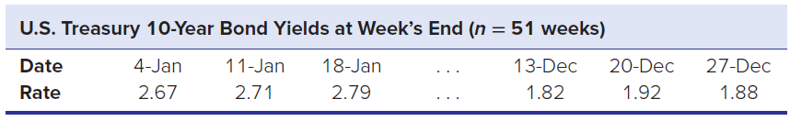
Question 7
LO 14-6
a. Make an Excel line graph of the following bond yield data (only the first and last three data values are shown). Describe the pattern. Is there a consistent trend?
b. Perform exponential smoothing with α = .20. Use both methods A and B to initialize the forecast. Record the statistics of fit.
c. Do the smoothing again with α = .10 and then with α = .30, recording the statistics of fit.
d. Compare the statistics of fit for the three values of α.
e. Make a one-period forecast (i.e., t = 53) using each of the three α values. How did α affect your forecasts? BondYield File

Slide 60
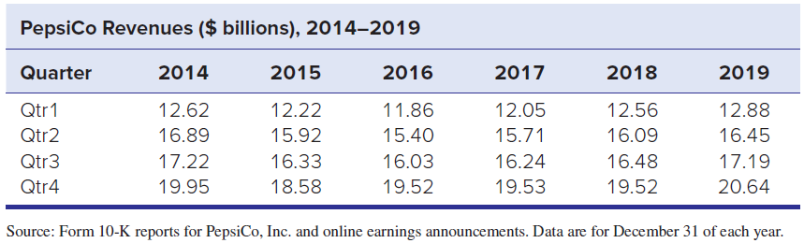
Question 8
LO 14-7, 8
a. Plot the PepsiCo data. Is there a trend?
b. Do you see evidence of seasonality?
c. Use software of your choice (e.g., MegaStat, Minitab, or R) to deseasonalize the data and calculate quarterly seasonal indexes.
d. If there is seasonality, suggest possible reasons.
e. Perform a regression using seasonal binaries. Interpret the results. PepsiCo File

Slide 61
Chapter 14 Analytics in Action

Slide 62
